Slide 1


Java
Recursion
Understanding and Implementation
A Comprehensive Guide to
Recursive Programming in Java
Java Programming Lecture Series

Slide 2





What is
Recursion
?
Definition
Conceptual Visualization
Recursion is a programming technique where a function calls itself to solve a problem by breaking it down into smaller instances of the same problem.
Key Characteristics
Solves problems by dividing them into smaller, similar subproblems
Requires at least one base case to terminate
Each recursive call works on a smaller version of the original problem
A recursive function breaks down a problem into smaller subproblems until it reaches a base case that can be solved directly.
Often provides elegant solutions to complex problems
Real-World Analogies
Russian Nesting Dolls
Organizational Hierarchy
File System
Each doll contains a smaller version of itself until reaching the smallest doll.
Each manager has subordinates who may also be managers with their own subordinates.
Folders contain files and subfolders, which may contain more files and subfolders.

Slide 3





Key Components of
Recursion
Essential Elements
Example: Factorial Function
1. Base Case
int
factorial(
int
n) {
The condition that stops the recursion
if
(n == 0 || n == 1) {
// Base case
Simplest form of the problem with a direct solution
return
1;
Prevents infinite recursion
}
Must be reachable for all possible inputs
else
{
// Recursive case
// Recursive work
return
n * factorial(n - 1);
2. Recursive Case
}
The part where the function calls itself
}
Breaks down the problem into smaller instances
Must move toward the base case
Combines solutions to subproblems
Component Breakdown
Base Case
- Terminates recursion
if (n == 0 || n == 1) return 1;
3. Recursive Work
Operations performed with the recursive results
Recursive Case
factorial(n - 1)
- Calls itself with smaller input
Combines or processes results from recursive calls
Recursive Work
- Combines current value with recursive result
Builds the final solution incrementally
n * factorial(n - 1)
Execution Flow for factorial(3)
factorial(3)
→
3 * factorial(2)
factorial(2)
→
2 * factorial(1)
factorial(1)
→
(base case)
1
2 * 1 = 2
3 * 2 = 6
Common Pitfalls
Missing Base Case
Not Approaching Base Case
Excessive Memory Usage
Leads to infinite recursion and stack overflow errors
Recursive calls must make progress toward termination
Each recursive call consumes stack space, potentially leading to overflow

Slide 4





Recursion
vs. Iteration
Two Approaches to Repetition
Detailed Comparison
Aspect
Recursion
Iteration
Recursion
Iteration
A function that calls itself to solve smaller instances of the same problem
Using loops (for, while) to repeat a process until a condition is met
Memory Usage
Higher (call stack)
Lower (no call stack)
Speed
Generally slower
Generally faster
Code Complexity
Often simpler and cleaner
Can be more complex
Same Problem, Different Solutions
// Recursive Factorial
// Iterative Factorial
Problem Suitability
Tree structures, divide & conquer
Linear problems, simple repetition
int
factorial(
int
n) {
int
factorial(
int
n) {
if
(n <= 1)
int
result = 1;
return
1;
i = 1; i <= n; i++) {
Termination
Base case
Loop condition
for
(
int
else
n * factorial(n - 1);
State Management
Implicit (call stack)
Explicit (variables)
return
result *= i;
}
}
return
result;
}
When to Choose Each Approach
Choose Recursion When:
Choose Iteration When:
The problem can be naturally broken down into similar subproblems
Performance and memory efficiency are critical
Working with tree-like or hierarchical data structures
The problem is linear in nature
Code readability is more important than performance
The number of iterations might be very large
Using divide and conquer algorithms
Stack overflow is a concern
The depth of recursion is known and limited
The solution requires maintaining explicit state
Examples: Tree traversal, quicksort, merge sort, binary search, Tower of Hanoi
Examples: Simple counting, data processing loops, numerical computation
Many recursive algorithms can be rewritten iteratively (and vice versa), but the choice should be based on readability, performance requirements, and the nature of the problem.

Slide 5



Simple Recursion Example:
Factorial
Factorial Definition
Recursive Implementation
The factorial of a non-negative integer n, denoted as n!, is the product of all positive integers less than or equal to n.
public
static
int
factorial(
int
n) {
// Base case
n! = n × (n-1) × (n-2) × ... × 2 × 1
if
(n == 0 || n == 1) {
return
1;
0! = 1 (by definition)
}
Examples:
// Recursive case
1! = 1
return
n * factorial(n - 1);
2! = 2 × 1 = 2
}
3! = 3 × 2 × 1 = 6
4! = 4 × 3 × 2 × 1 = 24
Key Points:
5! = 5 × 4 × 3 × 2 × 1 = 120
Base case:
n = 0 or n = 1, return 1
Recursive Definition:
Recursive case:
n > 1, multiply n by factorial(n-1)
Progress toward base case:
n decreases by 1 in each call
n! = 1 (if n = 0 or n = 1)
Termination:
Will reach base case when n ≤ 1
n! = n × (n-1)! (if n > 1)
Execution Trace for factorial(4)
Step 1
Step 2
Step 3
Step 4
Step 5
Call factorial(4)
Call factorial(3)
Call factorial(2)
Call factorial(1)
Unwinding begins
4 > 1, so recursive case
3 > 1, so recursive case
2 > 1, so recursive case
1 = 1, so base case
factorial(1) = 1
Return 4 * factorial(3)
Return 3 * factorial(2)
Return 2 * factorial(1)
Return 1
factorial(2) = 2 * 1 = 2
factorial(3) = 3 * 2 = 6
factorial(4) = 4 * 6 = 24
Call Tree Visualization
factorial(4)
Key Insight
factorial(3)
4 * 6 = 24
Each recursive call waits for its child call to complete before continuing. The results are combined as the call stack unwinds.
factorial(2)
3 * 2 = 6
factorial(1)
2 * 1 = 2
= 1

Slide 6


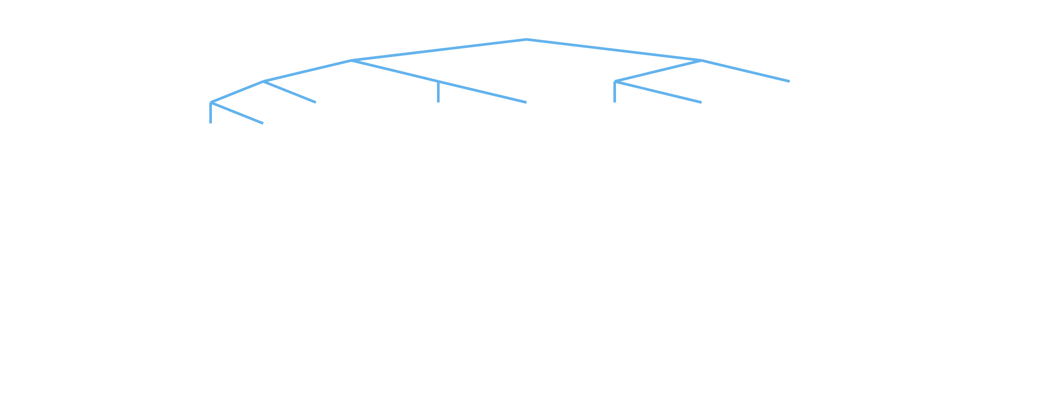
Recursion Example:
Fibonacci Sequence
Fibonacci Sequence
Recursive Implementation
The Fibonacci sequence is a series of numbers where each number is the sum of the two preceding ones, usually starting with 0 and 1.
public
static
int
fibonacci(
int
n) {
// Base cases
if
(n == 0) {
0, 1, 1, 2, 3, 5, 8, 13, 21, 34, ...
return
0;
}
F(n) = F(n-1) + F(n-2)
if
(n == 1) {
return
1;
Mathematical Definition:
}
F(0) = 0
// Recursive case
F(1) = 1
fibonacci(n - 1) + fibonacci(n - 2);
F(n) = F(n-1) + F(n-2) for n > 1
return
Examples:
}
F(0) = 0
F(1) = 1
Key Points:
F(2) = F(1) + F(0) = 1 + 0 = 1
Base cases:
F(0) = 0 and F(1) = 1
F(3) = F(2) + F(1) = 1 + 1 = 2
Recursive case:
F(n) = F(n-1) + F(n-2)
F(4) = F(3) + F(2) = 2 + 1 = 3
Progress toward base case:
n decreases in each call
F(5) = F(4) + F(3) = 3 + 2 = 5
Inefficiency:
Many redundant calculations
Recursive Call Tree for fibonacci(5)
F(5)
F(4)
F(3)
F(2)
F(2)
F(3)
F(1)=1
F(1)
F(1)=1
F(1)=1
F(1)=1
F(0)=0
F(2)
F(1)
F(1)
F(1)
F(0)
F(0)=0
F(0)
F(1)=1
F(1)
F(0)=0
F(0)
Observations:
Optimization Opportunities
Notice the
duplicate calculations
(F(3), F(2), etc. appear multiple times)
This naive recursive implementation is inefficient due to redundant calculations.
Time complexity is
O(2ⁿ)
- exponential growth
Better approaches include:
Space complexity is
O(n)
due to maximum call stack depth
• Iterative solution
• Memoization (caching results)
• Dynamic programming

Slide 7





Understanding the
Call Stack
What is the Call Stack?
Call Stack Visualization
The call stack is a data structure that stores information about active function calls in a program.
int
factorial(
int
n) {
if
(n <= 1) {
Each time a function is called, a new
return
1;
is pushed onto the stack
stack frame
}
When a function completes, its frame is popped off the stack
return
n * factorial(n - 1);
}
The stack operates in a
Last In, First Out (LIFO)
manner
Each Stack Frame Contains:
Call Stack for factorial(3)
Return address (where to go after function completes)
main()
Function parameters
Waiting for factorial(3) to return
Local variables
Other bookkeeping information
factorial(3)
n = 3
Key Insight
return 3 * factorial(2)
In recursion, each recursive call creates a new stack frame, allowing the function to maintain separate states for each call.
factorial(2)
n = 2
return 2 * factorial(1)
factorial(1)
n = 1
return 1 (base case)
Call Stack Unwinding
Step 1
Step 2
Step 3
Step 4
Final Result
factorial(1) returns 1
factorial(2) calculates
factorial(3) calculates
Return to main
factorial(3) = 6
factorial(1) = 1
factorial(2) = 2 * 1 = 2
factorial(3) = 3 * 2 = 6
main() receives 6
Stack is empty
The call stack unwinds in reverse order (LIFO):
Base case is reached (factorial(1) returns 1)
Control returns to factorial(2), which computes 2 * 1 = 2
Control returns to factorial(3), which computes 3 * 2 = 6
Control returns to main with the final result of 6
Each recursive call consumes memory on the stack. Deep recursion can lead to stack overflow errors.

Slide 8






Stack Overflow
Errors
What is a Stack Overflow?
Example of Infinite Recursion
A stack overflow occurs when a program attempts to use more memory for the call stack than has been allocated.
public
static
int
factorial(
int
n) {
// Missing base case!
return
n * factorial(n - 1);
In Java, this results in a
java.lang.StackOverflowError
}
Common Causes in Recursion:
Missing or incorrect base case
What Happens:
Base case never reached
1. factorial(5) calls factorial(4)
2. factorial(4) calls factorial(3)
Recursive calls not approaching the base case
3. factorial(3) calls factorial(2)
Extremely deep recursion (even with correct base case)
4. factorial(2) calls factorial(1)
5. factorial(1) calls factorial(0)
Stack Size Limits
6. factorial(0) calls factorial(-1)
7. factorial(-1) calls factorial(-2)
The JVM has a default maximum stack size (typically 1MB), which can be adjusted using the
8. ... continues indefinitely
-Xss
flag:
java -Xss2m MyRecursiveProgram
Eventually: StackOverflowError!
This sets the stack size to 2MB, but increasing stack size is often a band-aid solution rather than fixing the underlying issue.
Error Output:
Exception in thread "main" java.lang.StackOverflowError
at RecursionExample.factorial(RecursionExample.java:5)
at RecursionExample.factorial(RecursionExample.java:5)
at RecursionExample.factorial(RecursionExample.java:5)
at RecursionExample.factorial(RecursionExample.java:5)
... (repeated thousands of times)
Preventing Stack Overflow Errors
Ensure Proper Base Cases
Verify Progress Toward Base Case
Consider Alternatives
Convert to iteration when possible
int
factorial(
int
n) {
Ensure each recursive call moves closer to the base case:
Use tail recursion optimization
if
(n <= 1) {
// Base case!
return
1;
Implement memoization to reduce call depth
}
• Decreasing a counter
Use a custom stack implementation
return
n * factorial(n - 1);
• Reducing problem size
}
• Narrowing search space
Add validation to prevent invalid inputs:
if
(n < 0)
throw new
IllegalArgumentException();
Best Practice
Always test recursive functions with boundary cases and large inputs to ensure they handle edge cases properly and don't cause stack overflows.
Remember
Recursion depth is limited by available stack space. For problems requiring very deep recursion, consider iterative solutions or algorithms with reduced recursive depth.

Slide 9


Tail Recursion
Optimization
What is Tail Recursion?
Tail Call Optimization (TCO)
Tail recursion is a special case of recursion where the recursive call is the
Tail Call Optimization is a compiler technique that transforms tail-recursive calls into iteration, eliminating the need for additional stack frames.
last operation
in the function.
In other words, there are no pending operations after the recursive call returns.
Important:
Java does
NOT
perform automatic tail call optimization!
Regular Recursion vs. Tail Recursion:
How TCO Works:
Regular Recursion
Tail Recursion
1
Compiler recognizes that a function ends with a recursive call
2
Instead of creating a new stack frame, it reuses the current one
int
factorial(int n) {
int
factorial(int n, int acc) {
if
(n <= 1)
3
Parameters are updated and execution jumps back to the start
return
1;
if
(n <= 1)
4
This effectively transforms recursion into a loop
else
return
acc;
n * factorial(n-1);
return
else
return
}
factorial(n-1, n*acc);
Languages with TCO Support:
}
Scala
Kotlin
Haskell
Multiplication happens
the recursive call returns
after
Calculation happens
the recursive call
before
Scheme
Erlang
Elixir
Key Insight
In tail recursion, the recursive call is the final action, so there's no need to keep the current stack frame after making the recursive call.
Implementing Tail Recursion in Java
Converting to Tail Recursion
Benefits in Java
To convert a recursive function to tail-recursive form:
Even without compiler optimization, tail recursion in Java offers benefits:
1
Add an accumulator parameter to store intermediate results
More readable code for certain algorithms
2
Perform calculations before the recursive call
Easier to manually convert to iteration if needed
3
Pass the updated accumulator to the next recursive call
Good practice for functional programming concepts
4
Make the recursive call the final operation
Manual Optimization
In Java, create a public method that calls a private tail-recursive helper:
For performance-critical code in Java, manually convert tail-recursive functions to iterative versions:
public static int
factorial(
int
n) {
return
factorialHelper(n, 1);
public static int
factorial(
int
n) {
}
int
result = 1;
private static int
factorialHelper(
int
n,
int
acc) {
while
(n > 1) {
if
(n <= 1)
result *= n;
return
acc;
n--;
return
factorialHelper(n - 1, n * acc);
}
}
return
result;
}
While Java doesn't optimize tail recursion automatically, writing tail-recursive code is still valuable for clarity and as a stepping stone to iterative implementations when needed for performance.

Slide 10

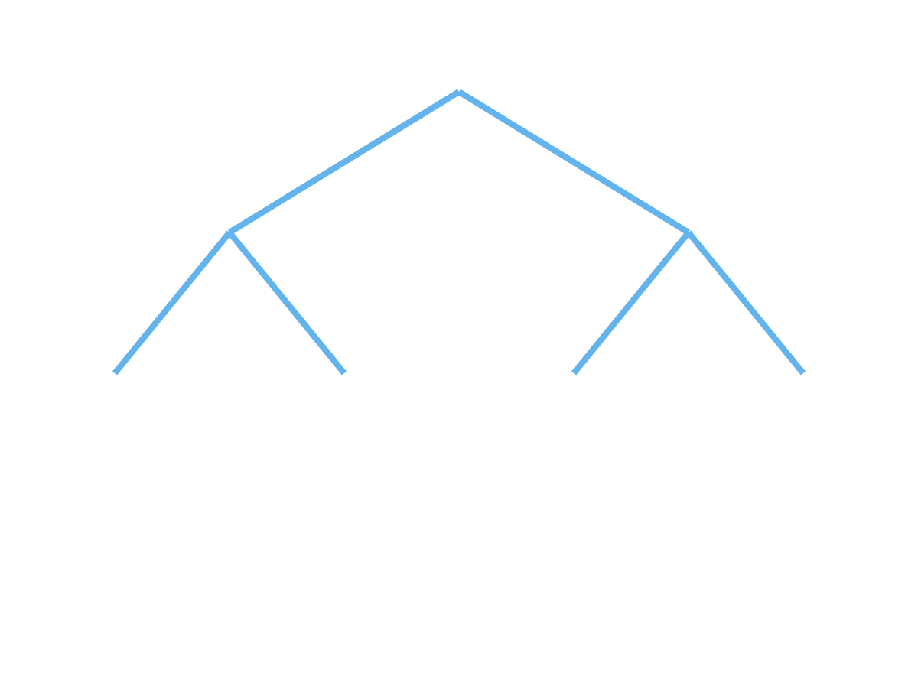
Advanced Example:
Binary Tree Traversal
Binary Tree Structure
Tree Traversal Methods
A binary tree is a hierarchical data structure where each node has at most two children, referred to as left and right child nodes.
Tree traversal is the process of visiting each node in a tree exactly once. There are three common depth-first traversal methods:
class
TreeNode {
int
value;
In-Order
Pre-Order
Post-Order
TreeNode left;
TreeNode right;
Left → Root → Right
Root → Left → Right
Left → Right → Root
For our sample tree:
For our sample tree:
For our sample tree:
public
TreeNode(
int
value) {
4, 2, 5, 1, 6, 3, 7
1, 2, 4, 5, 3, 6, 7
4, 5, 2, 6, 7, 3, 1
this
.value = value;
this
.left =
null
;
this
.right =
null
;
Why Recursion is Perfect for Tree Traversal:
}
}
Trees are naturally recursive structures
Each subtree is itself a tree
Sample Binary Tree:
Recursive solutions are elegant and concise
Base case: empty (null) node
1
Recursive case: process current node and its children
2
3
4
5
6
7
This tree would be constructed as:
TreeNode root =
new
TreeNode(1);
root.left =
new
TreeNode(2);
root.right =
new
TreeNode(3);
root.left.left =
new
TreeNode(4);
root.left.right =
new
TreeNode(5);
root.right.left =
new
TreeNode(6);
root.right.right =
new
TreeNode(7);
Recursive Implementations
In-Order Traversal
Pre-Order Traversal
Post-Order Traversal
void
inOrderTraversal(TreeNode node) {
void
preOrderTraversal(TreeNode node) {
void
postOrderTraversal(TreeNode node) {
if
(node ==
null
)
return
;
// Base case
if
(node ==
null
)
if
(node ==
null
)
return
;
// Base case
return
;
// Base case
// Recursive cases
inOrderTraversal(node.left);
// Left
// Recursive cases
// Recursive cases
System.out.print(node.value + " ");
System.out.print(node.value + " ");
postOrderTraversal(node.left);
// Left
// Root
// Root
inOrderTraversal(node.right);
// Right
preOrderTraversal(node.left);
// Left
postOrderTraversal(node.right);
// Right
}
preOrderTraversal(node.right);
// Right
System.out.print(node.value + " ");
// Root
}
}
Common use: Binary Search Tree (BST) traversal produces sorted output
Common use: Creating a copy of the tree or prefix expression evaluation
Common use: Deleting a tree or postfix expression evaluation
Key Insight
The only difference between these three traversal methods is the order in which we process the current node relative to its children. The recursive structure remains the same.
Other Tree Operations Using Recursion:
Considerations:
• Finding tree height/depth
For very deep trees, consider iterative approaches using stacks to avoid stack overflow
• Counting nodes
• Searching for a value
Time complexity: O(n) where n is the number of nodes
• Checking if two trees are identical
Space complexity: O(h) where h is the height of the tree (due to call stack)
• Converting a tree to its mirror image

Slide 11






Common
Recursion Patterns
Divide and Conquer
Backtracking
A strategy that breaks a problem into smaller subproblems of the same type, solves them independently, and combines their results.
A technique that builds solutions incrementally, abandoning a path as soon as it determines the path cannot lead to a valid solution.
Steps: Divide → Conquer → Combine
Steps: Choose → Explore → Unchoose
Merge Sort Example
N-Queens Example
void
mergeSort(
int
[] arr,
int
left,
int
right) {
void
solveNQueens(
int
row,
int
n,
int
[] queens) {
if
(left < right) {
if
(row == n) {
int
mid = left + (right - left) / 2;
printSolution(queens);
return
;
// Divide
}
mergeSort(arr, left, mid);
mergeSort(arr, mid + 1, right);
for
(
int
col = 0; col < n; col++) {
if
(isSafe(row, col, queens)) {
// Combine
queens[row] = col;
// Choose
merge(arr, left, mid, right);
solveNQueens(row + 1, n, queens);
// Explore
}
// Unchoose (backtrack) happens implicitly
}
}
}
}
Other Examples:
• Quick Sort
Other Examples:
• Binary Search
• Closest Pair of Points
• Sudoku Solver
• Strassen's Matrix Multiplication
• Permutations and Combinations
• Maze Solving
• Subset Sum Problem
Dynamic Programming with Recursion
Recursive Data Structure Traversal
Combines recursion with memoization to solve problems by breaking them down into overlapping subproblems.
Navigating hierarchical or nested data structures by applying the same operation to each element.
Key concept: Store solutions to avoid redundant calculations
Common with: Trees, graphs, nested objects, file systems
Fibonacci with Memoization
Directory Size Calculation
int
fibonacci(
int
n,
int
[] memo) {
long
calculateSize(File file) {
if
(n <= 1)
if
(file.isFile())
return
n;
return
file.length();
// Base case: file
if
(memo[n] != 0)
long
size = 0;
return
memo[n];
// Return cached result
File[] children = file.listFiles();
memo[n] = fibonacci(n-1, memo) + fibonacci(n-2, memo);
for
(File child : children) {
size += calculateSize(child);
// Recursive case
return
memo[n];
}
}
return
size;
}
Other Examples:
• Longest Common Subsequence
Other Examples:
• Knapsack Problem
• Edit Distance
• DOM Tree Traversal
• Matrix Chain Multiplication
• JSON/XML Parsing
• Graph Traversal (DFS)
• Composite Pattern Implementation
Pattern Recognition Tips
Identifying Divide & Conquer
Identifying Backtracking
Identifying DP Opportunities
• Problem can be split into identical subproblems
• Involves finding all (or some) solutions
• Overlapping subproblems
• Subproblems are independent
• Constraints can eliminate partial solutions
• Optimal substructure
• Results need to be combined
• Building solution incrementally
• Repeated calculations
• Problem size reduces with each division
• Need to explore multiple paths
• Exponential naive recursive solution
Key Insight
Recognizing these common patterns helps you approach new problems more effectively. Many complex problems can be solved by applying or combining these recursive patterns.

Slide 12

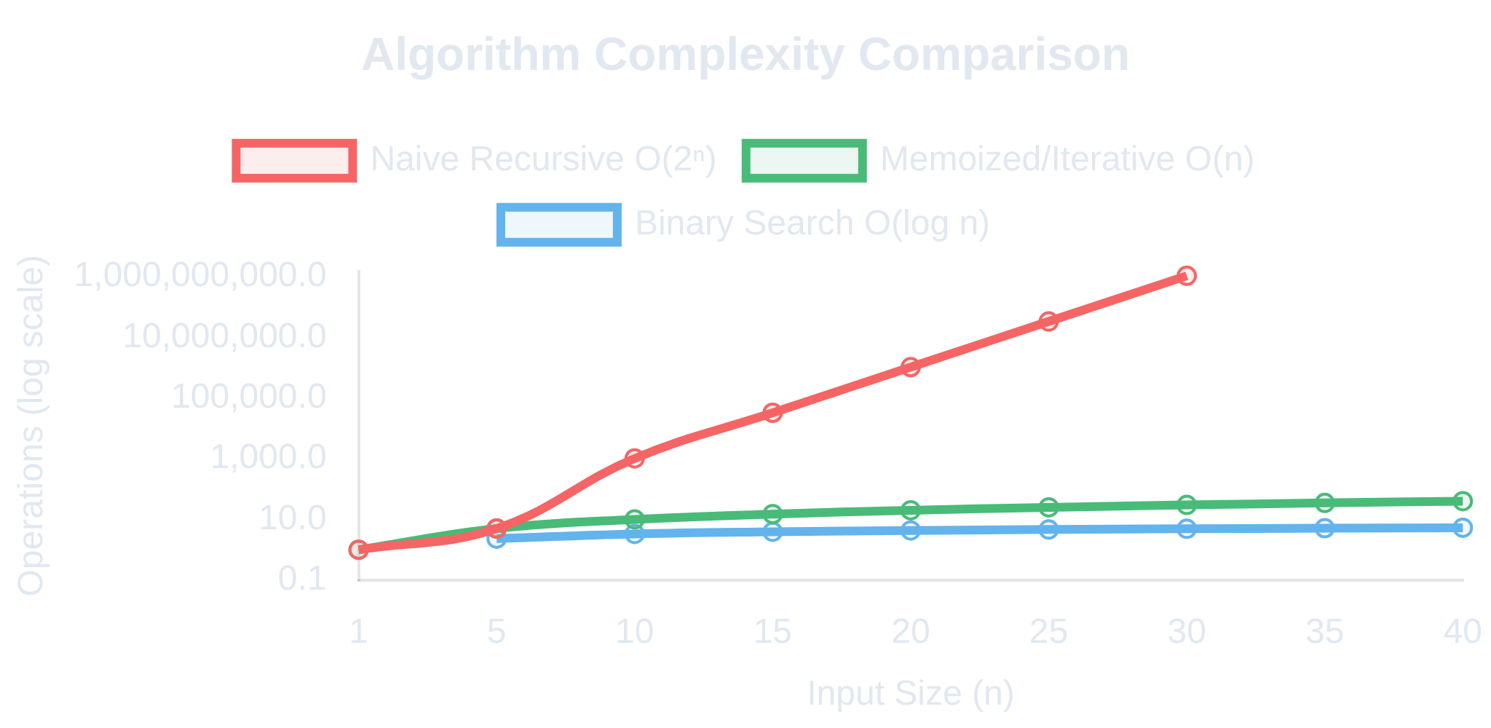





Performance
Considerations
Time and Space Complexity
Comparing Implementations
Recursive algorithms often have different time and space complexity characteristics compared to their iterative counterparts.
Time Complexity Factors:
Number of recursive calls
Work done in each recursive call
Branching factor (number of recursive calls per function)
Depth of recursion
Fibonacci Example
Binary Search
Space Complexity Factors:
Implementation
Time
Space
Implementation
Time
Space
Naive Recursive
O(2ⁿ)
O(n)
Recursive
O(log n)
O(log n)
Call stack depth (proportional to recursion depth)
Memoized
O(n)
O(n)
Iterative
O(log n)
O(1)
Size of data stored in each stack frame
Iterative
O(n)
O(1)
Additional data structures used (e.g., memoization tables)
In many cases, iterative solutions have better space complexity due to not using the call stack, while time complexity may be similar.
Optimization Strategies
Memoization
Tail Recursion
Iterative Conversion
Cache results of function calls to avoid redundant calculations.
Ensure recursive call is the last operation to enable potential compiler optimizations.
Convert recursive algorithms to iterative form for better performance when appropriate.
Map
<
Integer
,
Integer
> memo =
new
int
factorial(
int
n,
int
acc) {
// Instead of recursive factorial
HashMap<>();
if
(n <= 1)
return
acc;
int
factorial(
int
n) {
return
factorial(n-1, n*acc);
int
result = 1;
int
fib(
int
n) {
}
for
(
int
i = 1; i <= n; i++) {
if
(n <= 1)
return
n;
result *= i;
if
(memo.containsKey(n))
return
// Public wrapper
}
memo.get(n);
int
factorial(
int
n) {
return
result;
int
result = fib(n-1) + fib(n-2);
return
factorial(n, 1);
}
memo.put(n, result);
}
return
result;
}
When to Keep Recursion
When to Convert to Iteration
Problem is naturally recursive (trees, graphs)
Performance is critical
Code readability is more important than performance
Recursion depth could be very large
Recursion depth is known to be limited
Stack overflow is a concern
Memoization can effectively reduce redundant calculations
Memory usage needs to be minimized
Iterative solution is not significantly more complex
Always consider the trade-offs between code readability, maintainability, and performance when deciding between recursive and iterative approaches.

Slide 13

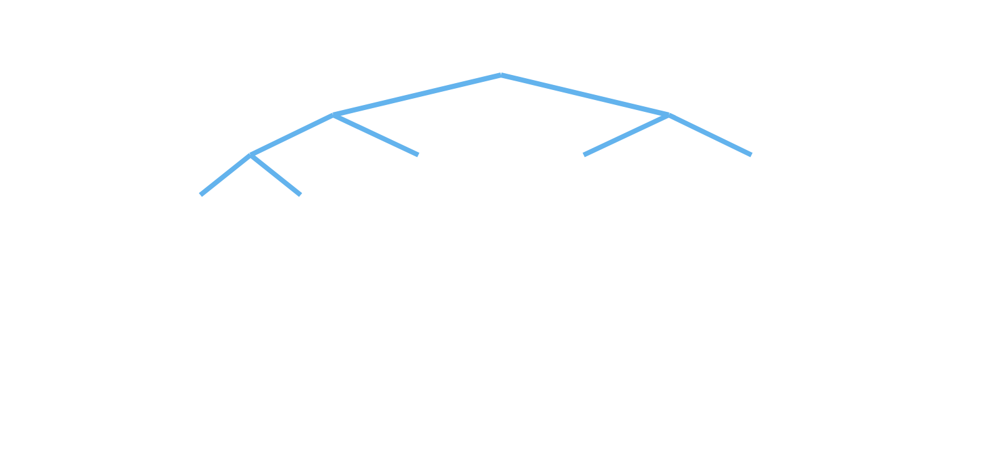
Memoization
Technique
What is Memoization?
The Problem: Redundant Calculations
Memoization is an optimization technique that stores the results of expensive function calls and returns the cached result when the same inputs occur again.
Consider the naive recursive Fibonacci implementation:
int
fibonacci(
int
n) {
if
(n <= 1) {
Think of it as a "remember what you've already calculated" approach.
return
n;
}
return
fibonacci(n - 1) + fibonacci(n - 2);
}
Key Benefits:
Dramatically improves performance for recursive functions with overlapping subproblems
Redundancy Visualization:
Reduces time complexity (often from exponential to linear)
For fibonacci(5), notice how many times fibonacci(2) is calculated:
Preserves the clean, recursive implementation
fib(5)
Enables solutions to problems that would otherwise be computationally infeasible
fib(4)
fib(3)
Trade-off
fib(2)
fib(2)
fib(3)
fib(1)
Memoization trades space for time: we use additional memory to store results, but gain significant speed improvements.
fibonacci(2) is calculated 3 times!
fib(2)
fib(1)
For larger values of n, redundancy grows exponentially
Implementing Memoization in Java
Using a HashMap
Using an Array
public static int
fibonacci(
int
n) {
public static int
fibonacci(
int
n) {
return
fibMemo(n,
new
HashMap<>());
if
(n < 0) {
}
IllegalArgumentException("Input must be non-negative");
throw new
private static int
> memo) {
fibMemo(
int
n, Map<
Integer
,
Integer
}
// Base cases
// Create memoization array
if
(n <= 1) {
int
[] memo =
new int
[n + 1];
return
n;
Arrays.fill(memo, -1);
// Initialize with -1 (uncalculated)
}
// Check if we've already calculated this value
return
fibMemo(n, memo);
if
(memo.containsKey(n)) {
}
return
memo.get(n);
}
private static int
fibMemo(
int
n,
int
[] memo) {
if
(n <= 1) {
// Calculate and store the result
return
n;
int
result = fibMemo(n - 1, memo) + fibMemo(n - 2, memo);
}
memo.put(n, result);
return
result;
if
(memo[n] != -1) {
}
return
memo[n];
}
Time complexity: O(n) - Each value is calculated exactly once
memo[n] = fibMemo(n - 1, memo) + fibMemo(n - 2, memo);
Space complexity: O(n) - For storing n values in the memo map
return
memo[n];
}
Array-based memoization is more efficient when:
• The input domain is numeric with a reasonable range
• Memory usage is a concern (arrays have less overhead than HashMaps)
Other Memoization Examples
Pascal's Triangle
Longest Common Subsequence
int
pascal(
int
row,
int
col,
int
[][] memo) {
int
lcs(String s1, String s2,
int
i,
int
j,
int
[][] memo) {
if
(col == 0 || col == row)
return
1;
if
(i == 0 || j == 0)
return
0;
if
(memo[row][col] != 0)
return
memo[row][col];
if
(memo[i][j] != -1)
return
memo[i][j];
memo[row][col] = pascal(row-1, col-1, memo) + pascal(row-1, col, memo);
if
(s1.charAt(i-1) == s2.charAt(j-1))
memo[i][j] = 1 + lcs(s1, s2, i-1, j-1, memo);
return
memo[row][col];
else
}
memo[i][j] = Math.max(lcs(s1, s2, i-1, j, memo), lcs(s1, s2, i, j-1, memo));
return
memo[i][j];
}
Best Practices
• Use memoization when you notice overlapping subproblems in recursive solutions
• Choose the appropriate data structure based on your input domain (HashMap for general cases, arrays for numeric ranges)
• Consider using a wrapper method to hide memoization details from the public API
• For very large inputs, consider bottom-up dynamic programming instead of top-down memoization

Slide 14




Best Practices for
Recursion
Design Principles
Implementation Strategies
Ensure Base Cases
Use Helper Methods
Always define clear base cases that will terminate the recursion.
Create private helper methods with additional parameters for tracking state.
int
factorial(
int
n) {
// Public API - clean and simple
// Base case - critical!
public
List
generatePermutations(String str) {
if
(n <= 1) {
List
result =
new
ArrayList<>();
return
1;
if
(str ==
null
|| str.length() == 0) {
}
return
result;
return
n * factorial(n - 1);
}
}
// Call helper with additional parameters
permutationHelper("", str, result);
return
result;
}
Validate Input
Check for invalid inputs to prevent unexpected behavior.
// Private helper with additional parameters
private void
permutationHelper(String prefix, String remaining, List
result) {
int
factorial(
int
n) {
// Implementation details...
// Input validation
}
if
(n < 0) {
throw new
IllegalArgumentException(
"Factorial not defined for negative numbers");
}
Avoid Redundant Calculations
// Rest of the function...
}
Use memoization to cache results of expensive calculations.
int
fibonacci(
int
n,
int
[] memo) {
if
(n <= 1)
return
n;
Progress Toward Base Case
if
(memo[n] != 0)
return
memo[n];
Ensure each recursive call moves closer to the base case.
memo[n] = fibonacci(n-1, memo) + fibonacci(n-2, memo);
❌ Wrong
✓ Right
return
memo[n];
}
void
badRecursion(n) {
void
goodRecursion(n) {
if
(n == 0)
return
;
if
(n == 0)
return
;
badRecursion(n);
// No progress!
goodRecursion(n - 1);
// Progress!
}
}
Consider Tail Recursion
Structure recursive calls to be the final operation in the method.
int
factorial(
int
n,
int
accumulator) {
if
(n <= 1)
return
accumulator;
return
factorial(n - 1, n * accumulator);
}
Practical Guidelines
Prevent Stack Overflow
Optimize Performance
Enhance Readability
Limit recursion depth for user inputs
Cache results with memoization
Use meaningful method and parameter names
Consider iterative solutions for deep recursion
Minimize work in each recursive call
Add comments explaining the recursive logic
Test with boundary cases and large inputs
Pass references instead of copying large objects
Clearly identify base cases and recursive cases
Use memoization to reduce call depth
Hide implementation details with helper methods
Consider bottom-up approaches for large inputs
When to Avoid Recursion
Consider alternatives to recursion when:
The problem can be easily solved iteratively
Performance is critical and memory usage is a concern
Recursion depth could be very large or unpredictable
The application runs in a memory-constrained environment
Remember: Recursion is a powerful tool, but it's not always the best solution. Choose the right approach based on the specific requirements of your problem, considering factors like readability, performance, and memory constraints.

Slide 15












Summary and
Key Takeaways
Core Concepts
Advanced Techniques
Definition
Memoization
Tail Recursion
Recursion is a programming technique where a function calls itself to solve a problem by breaking it down into smaller instances of the same problem.
Caching results to avoid redundant calculations
Making recursive call the final operation
Potential for compiler optimization
O(2ⁿ) → O(n) time complexity
Helper Methods
Recursion Patterns
Key Components
Using private methods with additional parameters
Common approaches to recursive problems
1
Base Case(s)
Condition(s) that stop the recursion
Cleaner public API
Divide & conquer, backtracking, etc.
2
Recursive Case(s)
Function calling itself with a simpler version of the problem
Common Applications
Execution Flow
Recursive calls build up on the call stack until a base case is reached, then results are returned back up the stack.
Tree Traversal
Sorting Algorithms
Binary Search
Function Call
Combinatorial Problems
Graph Algorithms
File System Operations
Recursive Calls
Base Case Reached
Return Results
Best Practices & Considerations
Do's
Don'ts
Trade-offs
• Always define clear base cases
• Forget base cases
Recursion vs. Iteration
• Ensure progress toward base case
• Ignore stack overflow risks
Consider readability, performance, and memory usage
• Validate inputs
• Use recursion for simple iterative problems
Time vs. Space
• Use memoization for overlapping subproblems
• Repeat calculations unnecessarily
Memoization trades memory for speed
• Consider tail recursion
• Ignore performance implications
Elegance vs. Efficiency
• Test with boundary cases
• Use recursion blindly without considering alternatives
Sometimes iterative solutions are more efficient
Final Thought
Recursion is a powerful tool in a programmer's toolkit. Understanding when and how to use it effectively can lead to elegant solutions for complex problems. However, always consider the trade-offs and be mindful of its limitations.

Slide 16









Questions
& Answers
Thank You!
Any questions about Java recursion?
Common Questions
Additional Resources
When should I use recursion vs. iteration?
Java Documentation
How do I prevent stack overflow errors?
Practice Problems: LeetCode, HackerRank
Can all recursive solutions be converted to iterative ones?
Video Tutorials: Recursion Visualized
How does memoization improve performance?
Java Community Forums
Practice Makes Perfect
The best way to master recursion is through practice. Start with simple problems like factorial and Fibonacci, then gradually move to more complex problems like tree traversals and backtracking algorithms.
Remember: Think about the base case first, then how to break down the problem into smaller instances!
Contact Information
instructor@example.com
Office Hours: Mon-Fri, 10AM-4PM

